Slide 1
Data Passing Between Activities
IN721 2019
Design and Development for Mobile Devices
Session 4.2
Notes:
We’ve now spent some time moving from Activity to Activity, which is good.
Most of the time, Activities aren’t independent from each other.
But frequently, we need to pass data along from one activity to another when we launch it, and/or to return data from launchee to launcher.

Slide 2
Communication Between Activities
Two cases:
Activity 1 passes data directly to Activity 2 when it transfers control.
Activity 1 requests data from Activity 2 (i.e. Activity 2 will return a result to Activity 1).
Notes:
There are two cases:
Activity 1 passes data directly to Activity 2 when it transfers control.
Activity 1 requests data from Activity 2 (i.e. Activity 2 will return a result to Activity 1).

Slide 3
Case 1: Passing Data When Launching
Data that are to be passed into an Activity on launch are embedded into the Intent via Intent.putExtra(data).
putExtra(String dataName, Bundle dataValue).
Notes:
Bundle is a complex string wrapper that we will look at in more detail later.
For the moment, simply note that if a method wants an object of type Bundle, you can give it a literal string.
So putExtra is, in effect, building an associative array or key/value data structure. dataName is the key and dataValue is the value.

Slide 4
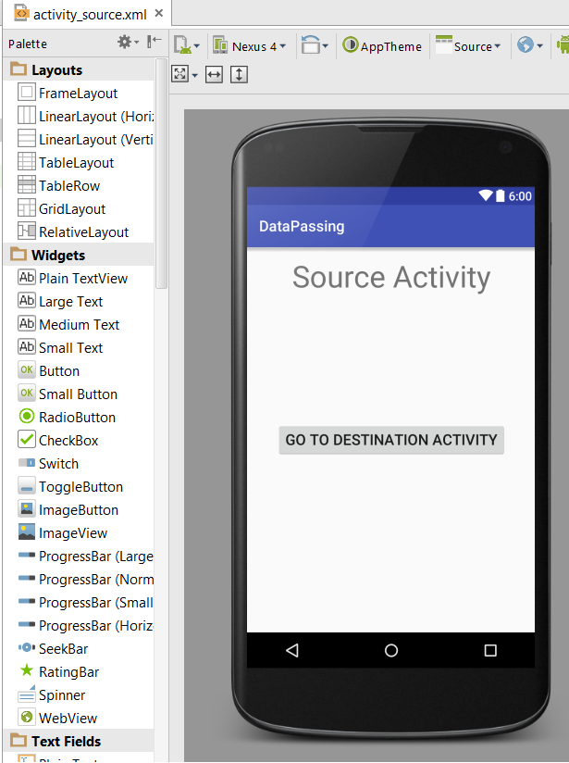
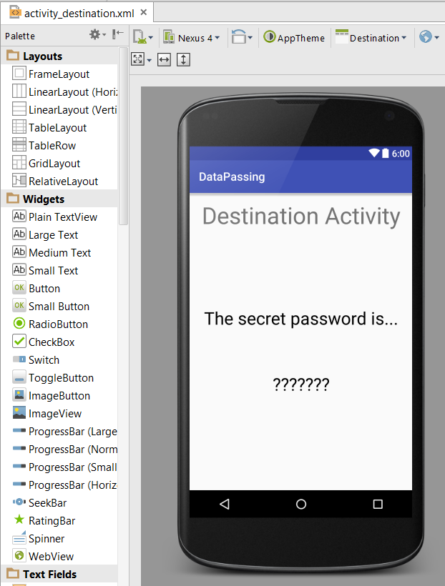
Case 1: Passing Data When Launching
Notes:
We have these two activities. Assume that the Source Activity (the Launch Activity) has code to get the secret password (perhaps from an authorised database fetch, although in this example, we just hard code it...)
It is going to launch the Destination Activity and pass the secret password along. The Destination Activity will display it in the textView with ???

Slide 5
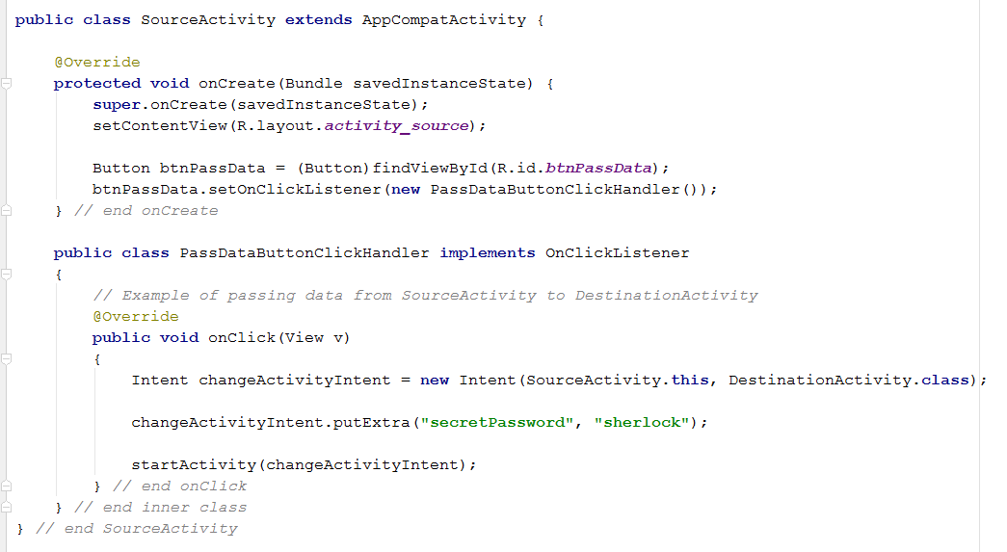
Passing Data When Launching
Notes:
Here is SourceActivity getting its button wired up to launch DestinationActivity and pass in the secret password (implemented here as a hard-coded string, but it works the same regardless of how you get the string).
It is passing a key-value pair whose key is “secretPassword” and whose value is “sherlock”
The only new thing here is the putExtra.

Slide 6
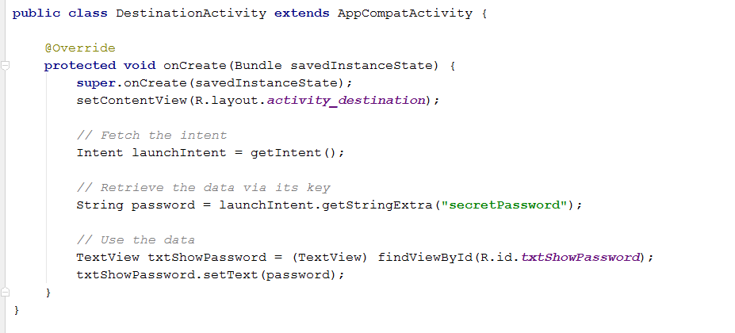
Retrieving Passed Data
Get a reference to the Intent that launched you
Use various methods to grab the putExtra data
Notes:
How will DestinationActivity get the data that SourceActivity sent it?
We get the intent with getIntent(). This is an Activity method.
(What do you think happens if you call getIntent from inside a main activity? ➔ You get an intent launched by the system.)
We get the string with the getStringExtra method of the intent instance. We pass in the key value.
We can then use the string as normal.

Slide 7
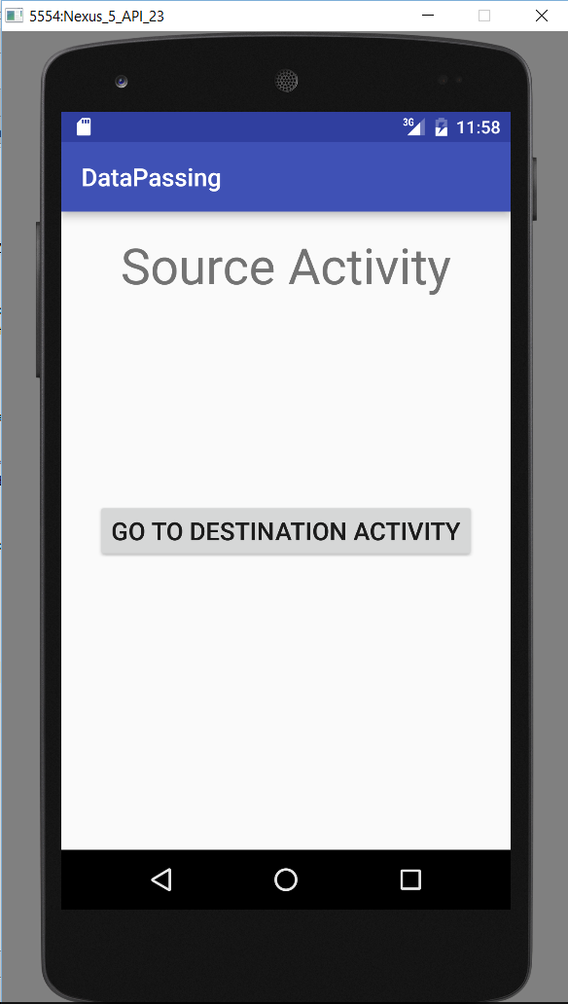
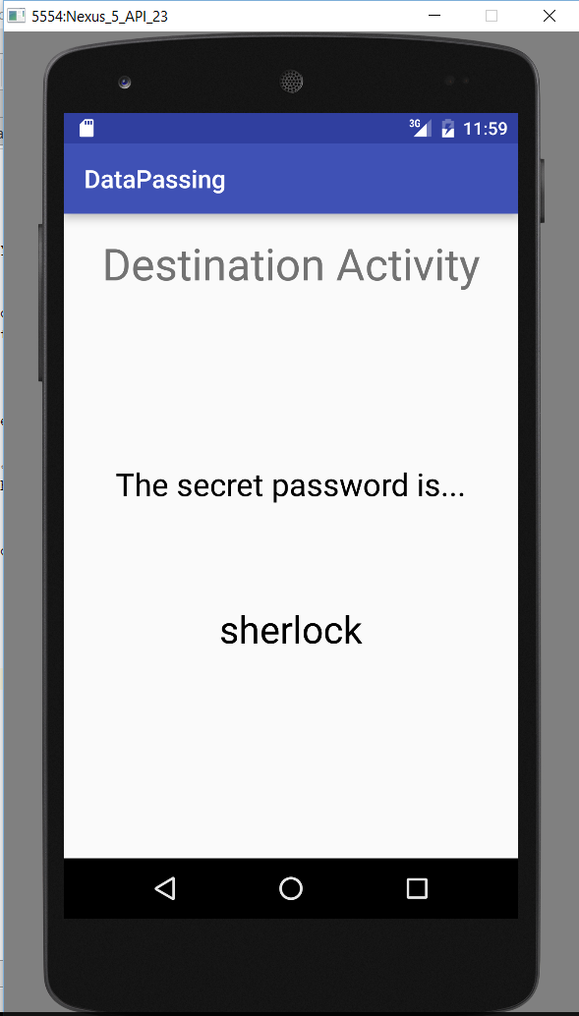
Passing Data When Launching

Slide 8
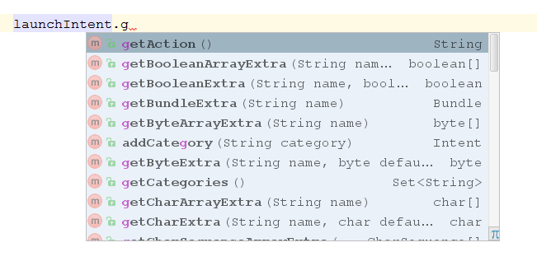
Retrieving Passed Data
Notes:
Here are some more of the “getXxxxxExtra” methods of the Intent class

Slide 9
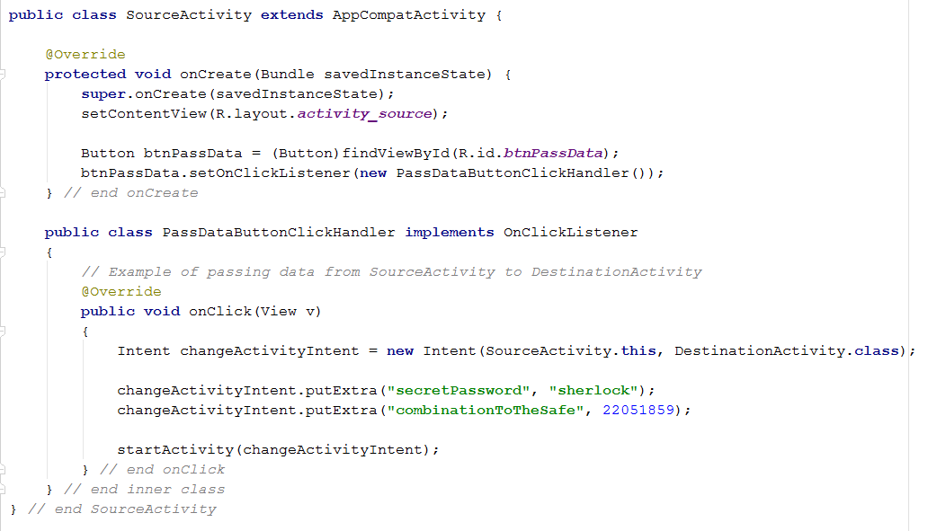
Passing Multiple Items
Notes:
The launching activity can pass in as many extras as it wishes.
Here, we pass a string and an int...
In the destination activity, we can pull the values out one-by-one by their keys, or...

Slide 10
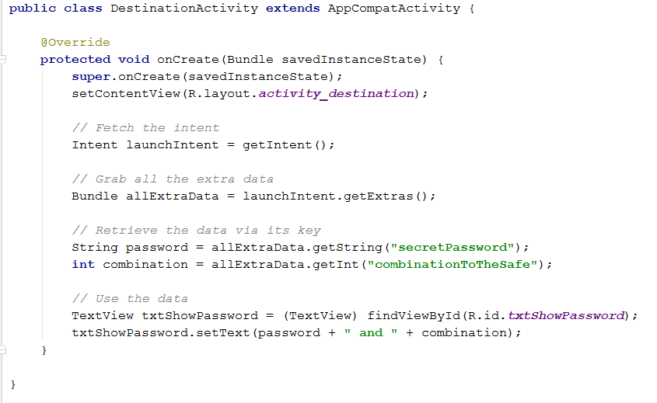
Retrieving Passed Data
Syntactic Alternative
Notes:
You can pull all the extras out into a Bundle, and grab data from there as needed.
Note you say getString to the Bundle, not getStringExtra.
There are slight technical differences when dealing with null results, but for now you can use whichever approach you prefer.

Slide 11
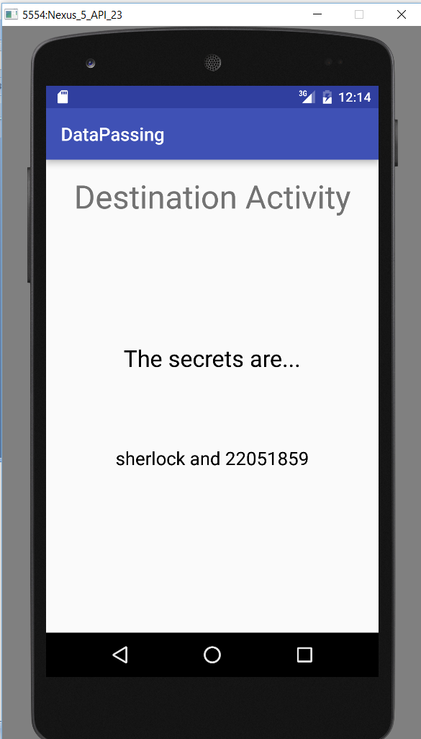
Retrieving Passed Data
Notes:
The new destination output with the two extras... (static text view changed to preserve grammatical correctness).

Slide 12
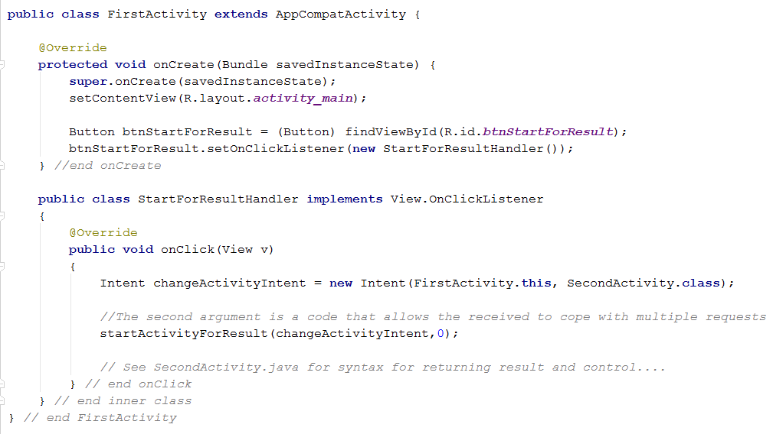
Case 2: Requesting Data
public void startActivityForResult (Intent intent, int requestCode)
Notes:
Case 2: Requesting data from an activity when you launch it.
This is sort of like calling a function that returns a value, except the transfer of control is more dramatic.
Control will be transferred to the called activity (SecondActivity), who will return control back to the caller (this one, FirstActivity).
We see how that is done in a moment, but you actually already know most of it.
Instead of startActivity we use startActivityForResult
The intent is an instance which names the launcher and launchee as before, as before.
The requestCode is any number. You will use this to distinguish between multiple launch requests (an Activity, as we have seen can want to launch different intents depending on user input or the computational situation).
NB: We also need to write code to deal with when control and result are returned. We will see this in a minute.
But first, let’s look at what the called activity does...

Slide 13
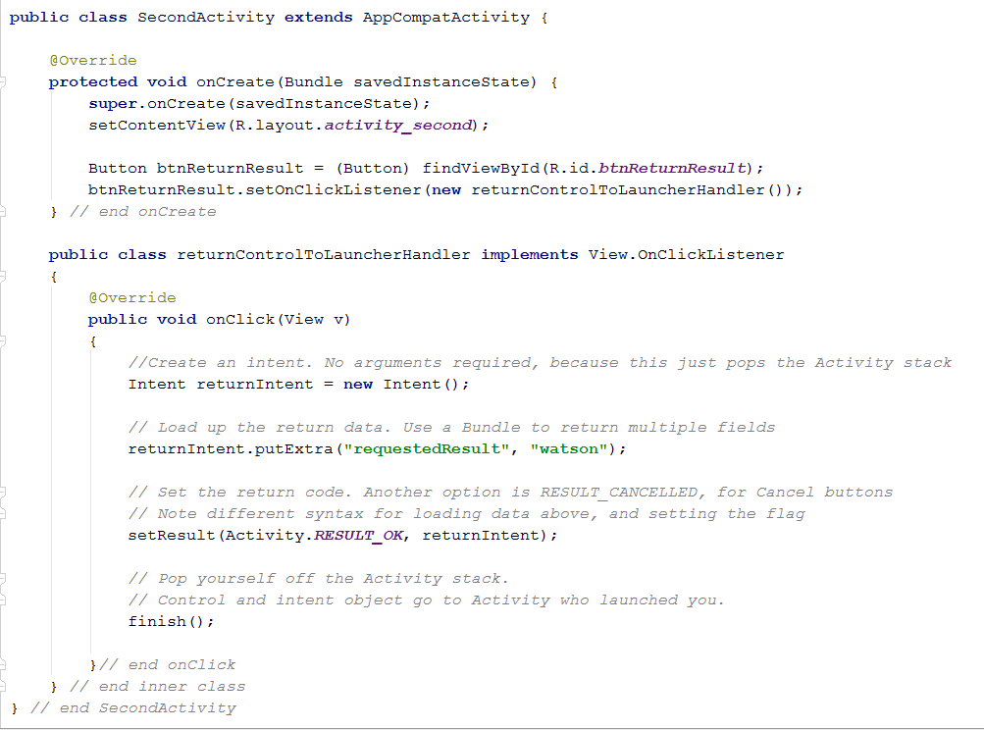
Target of startActivityForResult
Notes:
Observe the steps
Create a new intent, to use to return control. That is, you will launch the guy who launched you. No args are required because you were launched via startActivityForResult. When you call finish(), which happens in a moment, control is returned to the guy who launched you.
Load the intent up with a key-value pair of data using putExtra
Load the intent up with a termination code. The caller will use this to confirm that everything worked out ok (or not)
Note the different syntax. So it goes.
Call finish. This pops you off the stack, and returns control to the caller (who will be the next top of the stack). The intent is delivered along with the transfer of control.
So FirstActivity will resume. What does it do to get the data that has been returned to it?

Slide 14
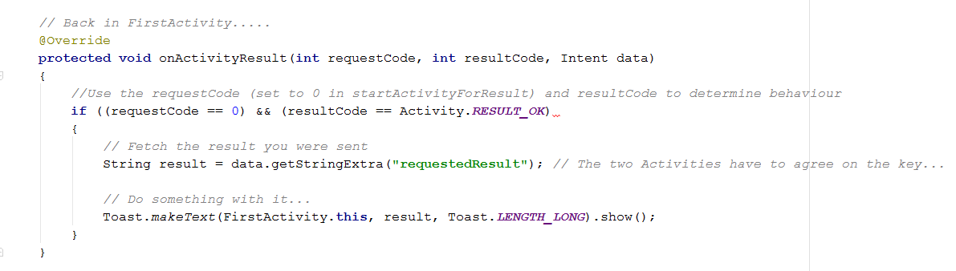
Retrieving the Requested Data
Override onActivityResult(args).
This event is raised automatically when control is returned to the Activity.
Notes:
This method is called automatically in response to the finish() of the previous activity.
Note that the returning Intent is passed into the method as an argument (that is, automatically by the system), so we don’t have to use getIntent()
Maybe it would be better to be consistent, maybe not. Think about why the language designers have chosen this architecture.
The requestCode is that number you put in when you called. In this case, 0.
This lets you potentially launch multiple requests from within an activity, and distinguish which one foregrounded you.
The resultCode is what you set in the called Activity before finish()
If everything is as expected, grab the data from the intent as before, and use it.
Here’s what the app looks like when running...

Slide 15
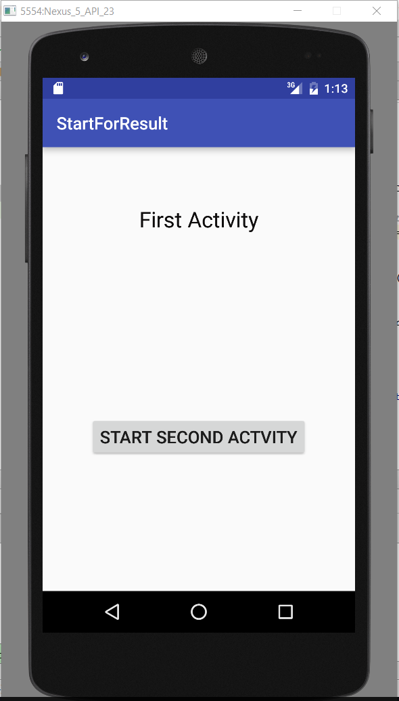
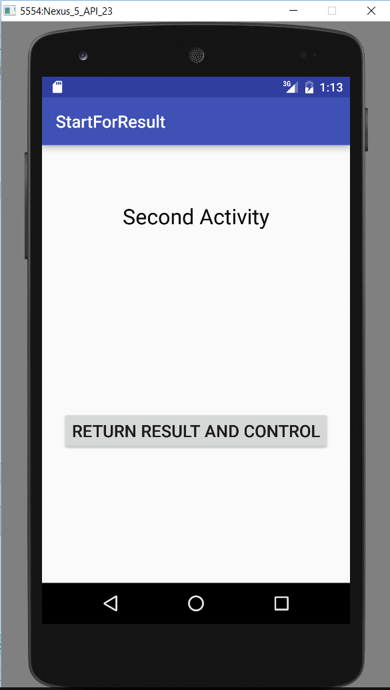
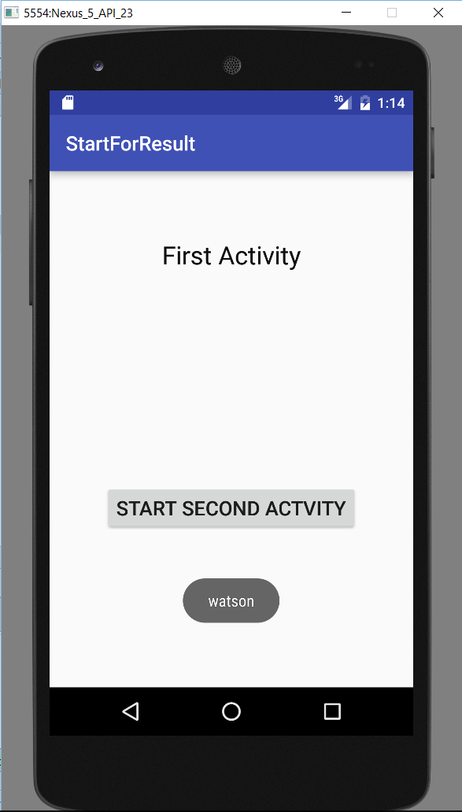
Case 2: Requesting Data
Notes:
We click the button and launch the startActivityForResult, transferring control to SecondActivity...
Recall that when we click the button here in SecondActivity, we do the prepare-Intent-and-finish stuff
That will return us to FirstActivity passing the result intent
We end up back at FirstActivity, and the Toast shows that onActivityResult has been executed
Thought exercise:
If I hit the phone back arrow now, do I see SecondActivity? => No. “Back” is not “in time”, it’s “down the stack”. You will actually see whatever was on the screen before you launched the app.
SecondActivity was popped off the stack, returning control to FirstActivity. It didn't launch FirstActivity (which would have left an instance of it on the stack).

Slide 16
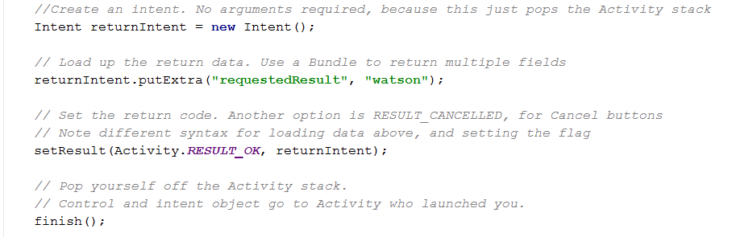
What Happens...
If you put this code in SecondActivity’s onCreate method, not in a button click handler...
Notes:
In our example, the return doesn't happen until the button is clicked, but this code can, of course, go into any appropriate event handler.
What would happen, for example, if this code was in the onCreate?
Does the app still run? ➔ Yes.
Do you see SecondActivity? ➔ No, it never gets the screen
Does FirstActivity pop the Toast? ➔ Yes, and it says watson, as it should.

Slide 17
Practical
Notes:
See handout

